Slide 1
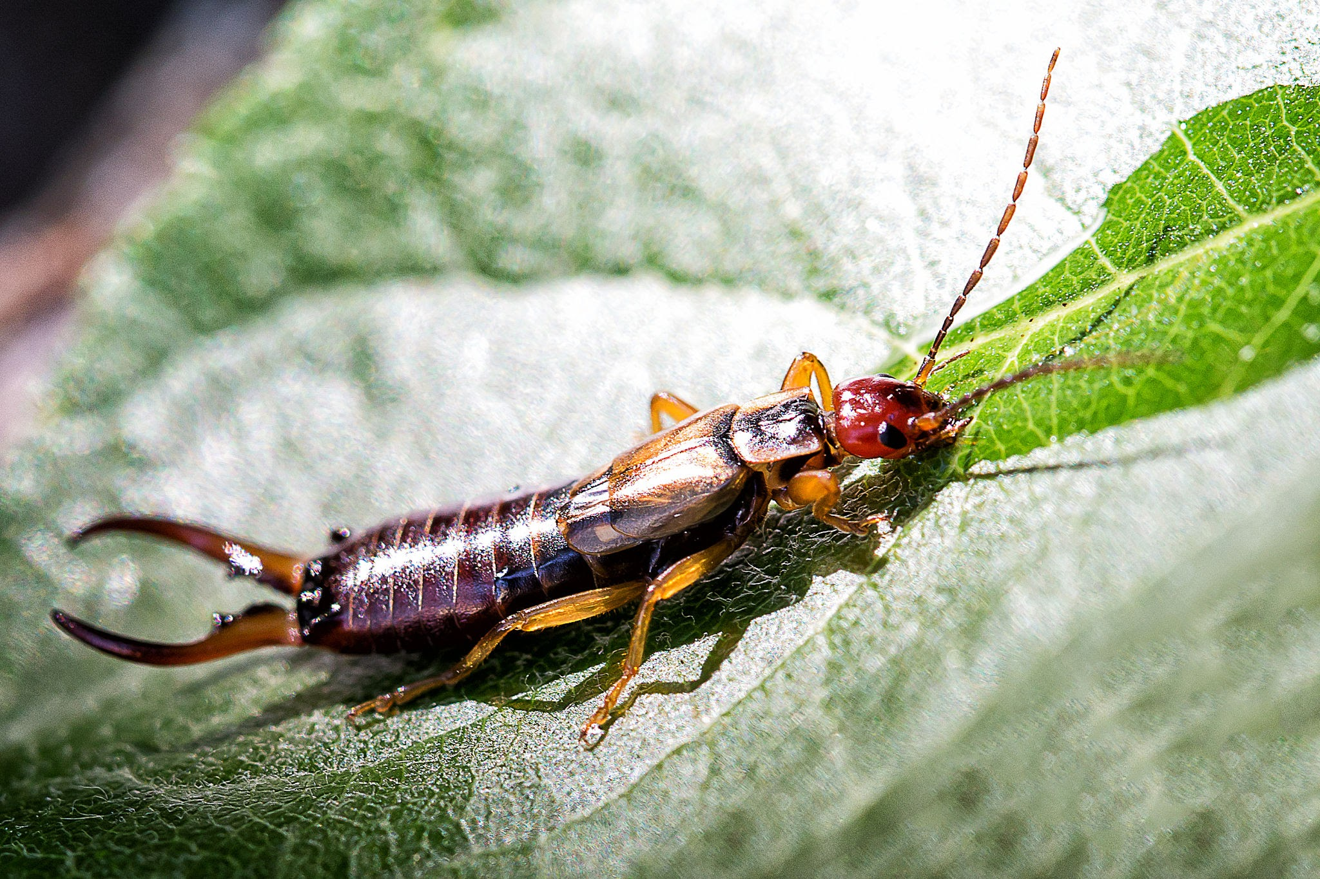
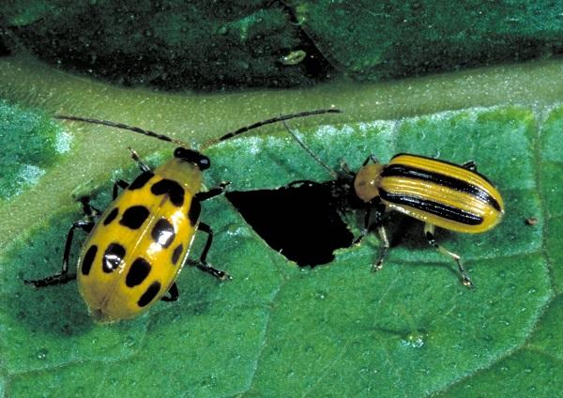
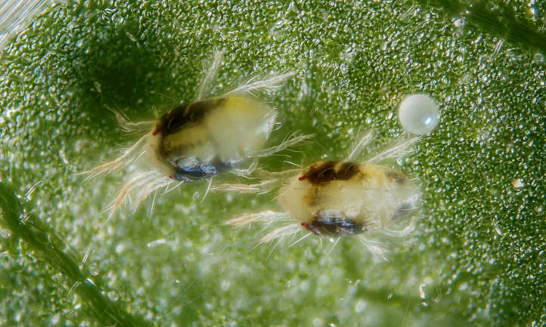
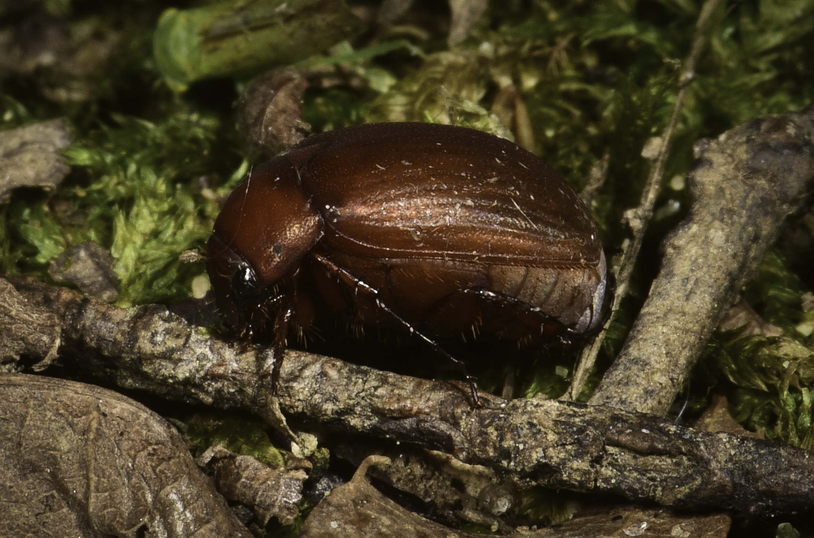
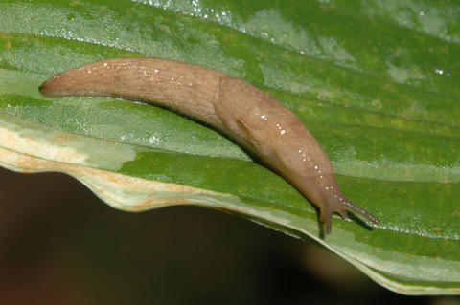
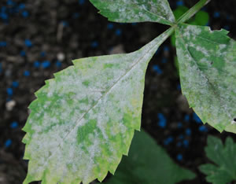
Integrated Pest Management
Focus on most common pests
Describe life cycle, active period, nature of damage
Methods of control

Slide 2
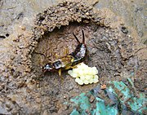
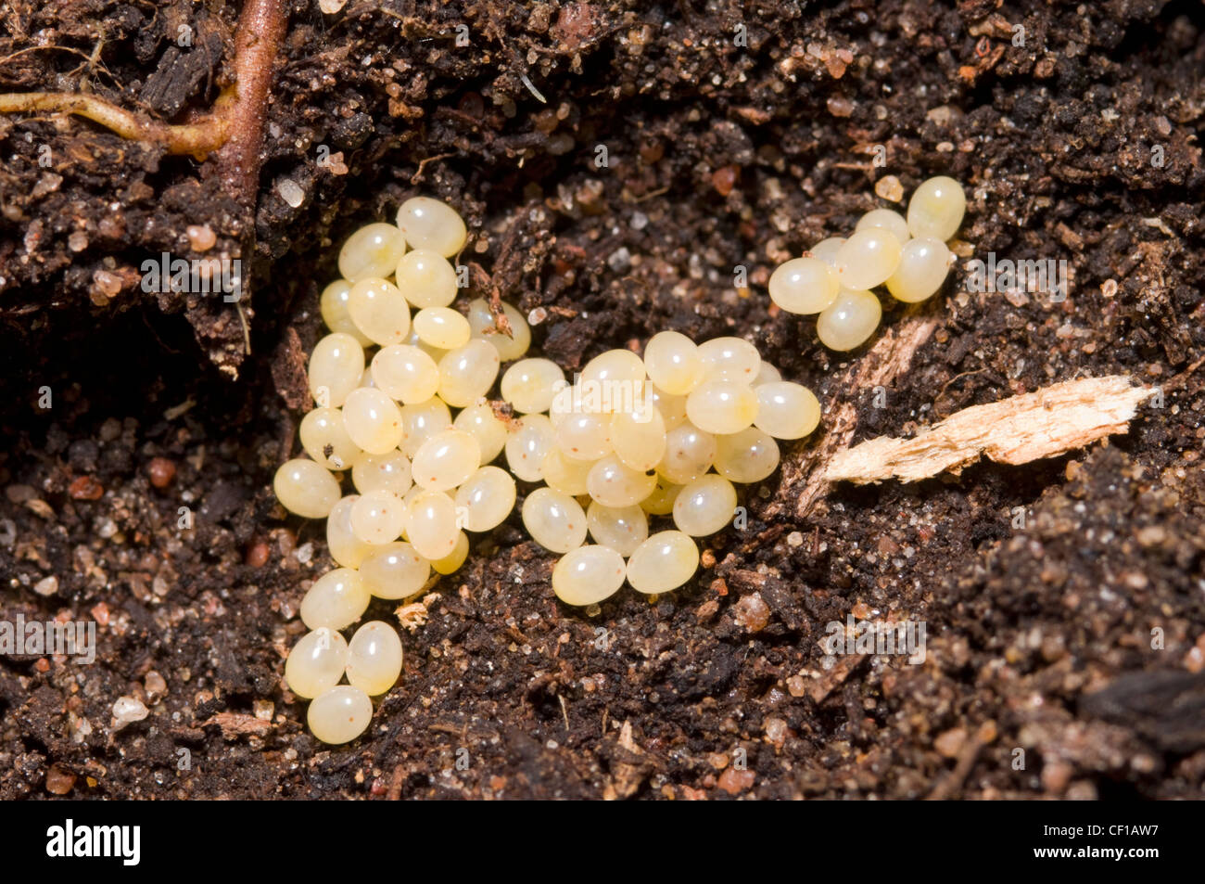
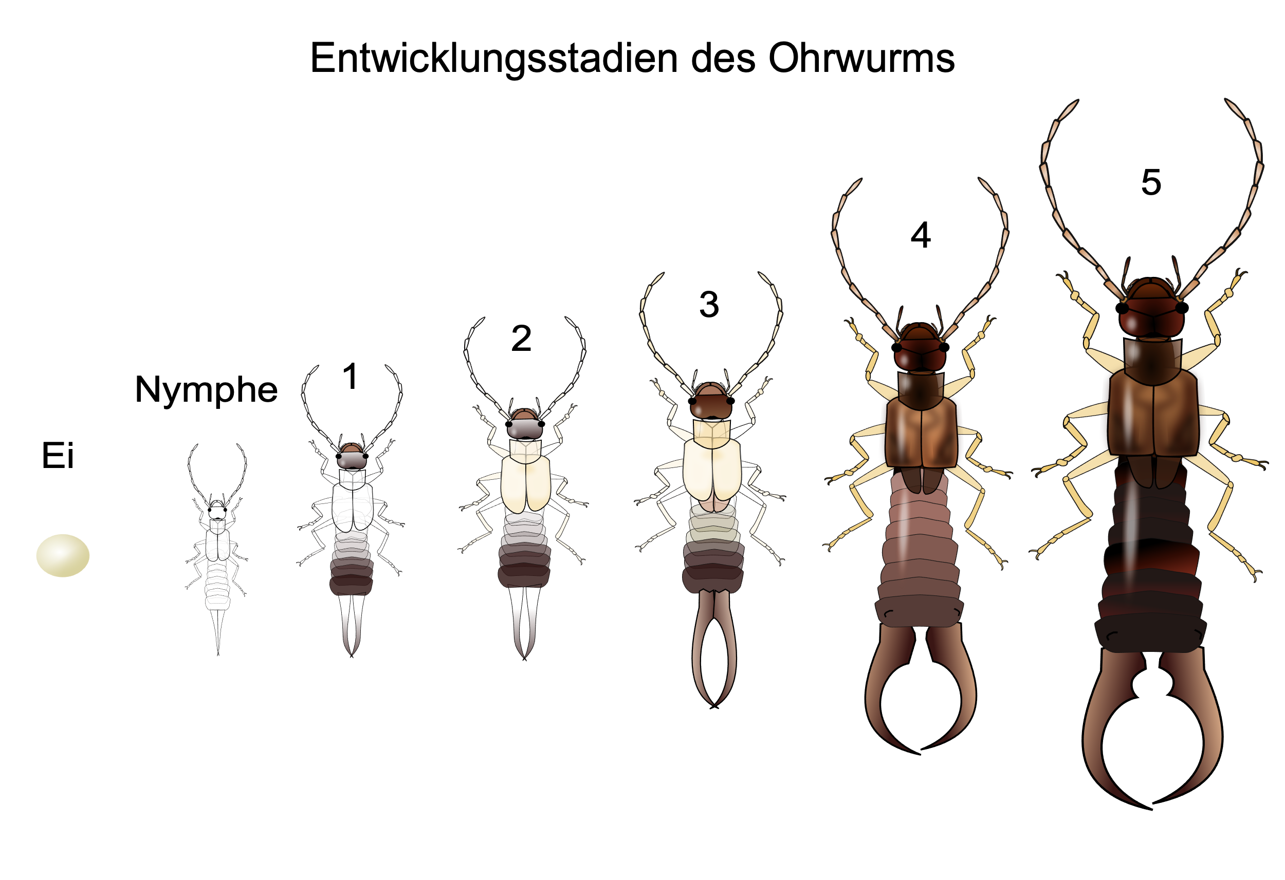
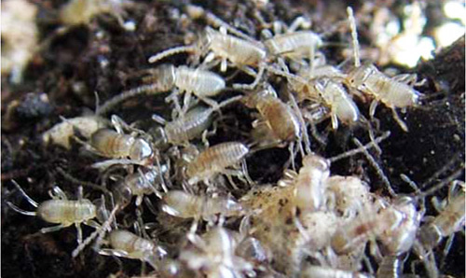
Earwig-Life Cycle
The life cycle of the earwig consists of egg, nymph and adult.
In early spring, after overwintering in soil, the female earwig lays up to 60 eggs in a nest about 2-3” below soil- twice a year
In about seven days, the eggs hatch and nymphs emerge
Female guards the eggs and newly hatched young until the first molt, when they leave the nest.
Emerge near full adulthood in late May or early June.
Active July-September

Slide 3
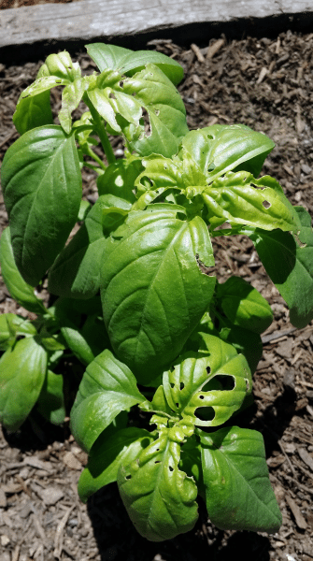
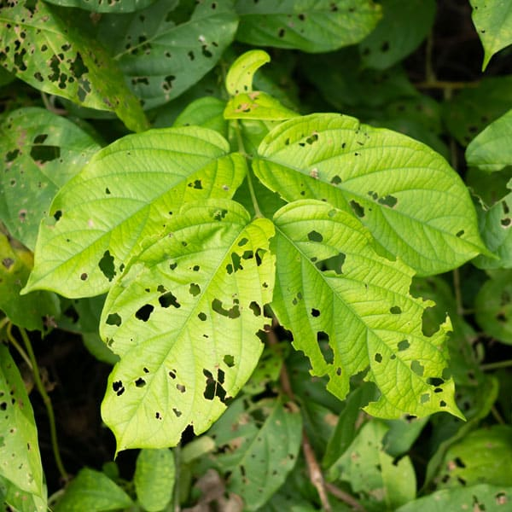
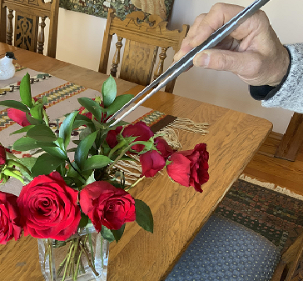
Earwigs
Scavengers of decaying matter and predators of insect larvae, slug eggs, aphids, seedlings AND plant leaves
Active at night
During day hide-out in soil—prefer organic soils
Worst damage occurs early after dahlias are planted
Earwigs make small holes in leaves-to make sure you need go
out at night with a flashlight or headlamp to verify it is earwigs
Can consume entire young plants or an severely damage them
Control:
  Remove at night with forceps-(my preferred method)
  Role newspaper and place around base of plant—earwigs seek a dark, damp place to hide during day- dump earwigs into a container with soapy water in the morning
  Oil traps placed flush with ground
  Mixture of rubbing alcohol and water-contact spray-beware of damaging plant

Slide 4
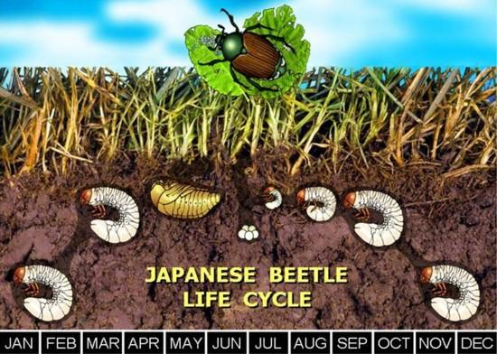
Copper Ground Beetle
Relatively new pest from Europe that was first detected in New Jersey but is now in Michigan
Like most beetles it has a soil developing grub stage
Adults appear in June and remain active through July
Adults are active at night-during the day they hide in ground
Adults eat leaves, flower petals of almost all plants including dahlias
Damage looks similar to earwig damage
Control
  Remove at night with forceps-(my preferred method)
  Treat lawn with Grubex

Slide 5
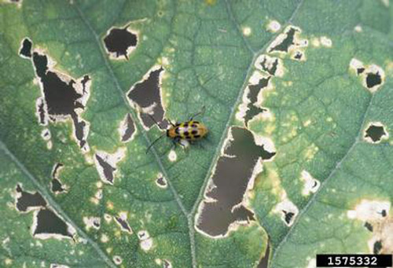
Cucumber Beetles
Can damage leaves and flowers
Active during the day
Tend to be a problem later in the season
Control
  Spinosad, pyrethrin insecticides and neem oil
  can effectively manage cucumber beetle, though you
  will likely need to apply more than once.
  Sevin --spray plant surfaces thoroughly to kill by contact and protect against cucumber beetles for up to three months
  Flowers like nasturtium and marigolds, catnip may help keep cucumber beetles away

Slide 6
Slugs- Life cycle
Slugs typically spend the winter as eggs in protected sites, like under plant debris, mulch, boards or in the soil
Eggs hatch the following spring and early summer
If conditions are favorable, slugs can be active throughout the summer and fall
Slugs have a layer of slime to protect their skin from drying up and to reduce predation

Slide 7
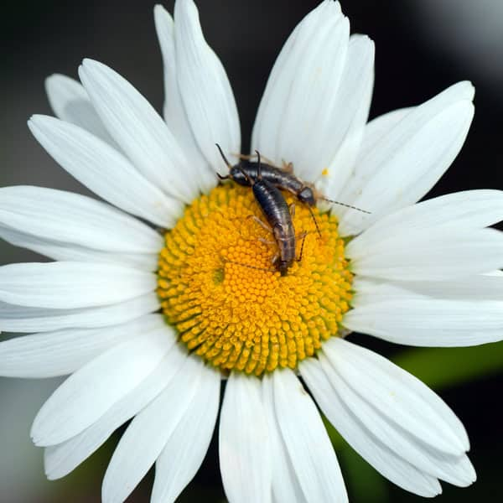
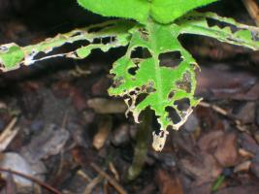
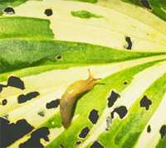
Slugs-Damage
Active at night
Worst damage can occur on young dahlia plants
Make small holes in leaves similar to earwigs only
usually larger and with jagged edges and slime residue
To make sure what is eating leaves you need go out at night
with a flashlight or headlamp to verify the damage is from slugs
Can consume entire young plants or severely damage them
Tends to be a bigger problem for dahlia gardens that do not get full sun
most of the day or gardens with substantial ground cover

Slide 8
Slugs-Control Measures
Remove at night with forceps (a little too sticky for this method)
Spray slugs at night with 1 part ammonia and 5 parts water (they will dissolve before your eyes and spray will not damage plants)
Set out several flat boards, shingles or damp newspapers for them to hide under during the day
Set out beer traps
Baits
  Iron phosphate (less effective but not toxic to children and pets)-Sluggo
  Ferric sodium EDTA (less toxic to iron phosphate, works faster)
  Metaldehyde (attractive and toxic to dogs and other animals) Deadline
Baits work best if used early in spring as a preventative measure and to kill recently hatched young of the year
Must be periodically re-applied

Slide 9
Spider Mites
Spider mites are members of varying mite species with piercing, sucking mouthparts that feed on individual plant cells.
Most of the time you won’t notice spider mites because of their size.
They aren’t visible to the naked eye, but you can see them with a 10x magnifying glass.
Often they look like small, light dots crawling on leaves or in webs. They are just .1 inches at maturity.
They congregate on the undersides of leaves.
A spider mite infestation is easily identifiable when their silk webbing is wound around infested leaves.

Slide 10
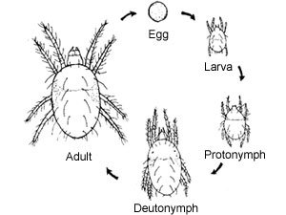
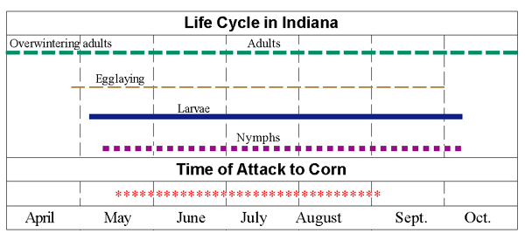
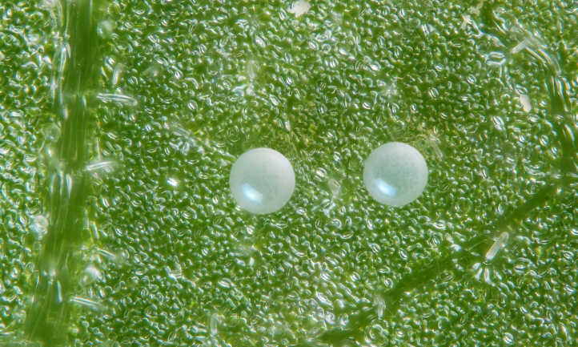
Two Spotted Spider Mites- Life Cycle
Spider mites go through five different stages of life: egg, larva, protonymph, deutonymph and adult
Adult spider mites lay eggs on the underside of leaves. An adult can lay as many as 100 eggs throughout a three-week period of time.
Adults can carry out mite reproduction sexually or asexually
Under optimum conditions of high temperatures and low humidity, this mite can complete its development in 5 to 7 days
In Michigan spider mites usually appear in late May –Early June depending on weather conditions

Slide 11
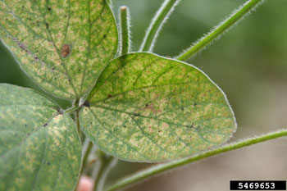
Spider Mites
The two spotted spider mite survive winter as adults hidden in protected areas such as bark cracks, bud scales or under debris around the garden or in soil

Slide 12
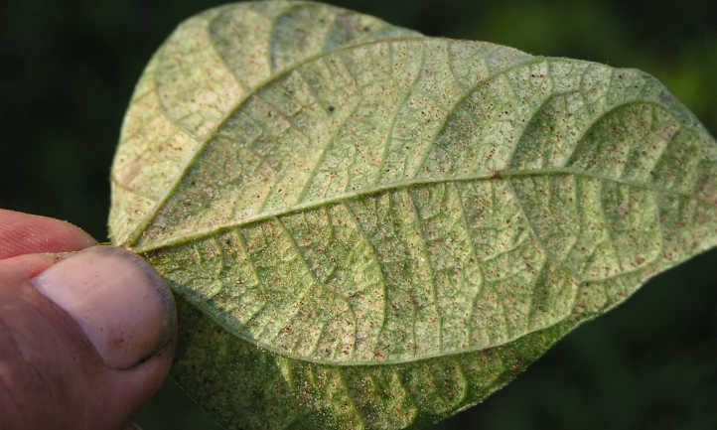
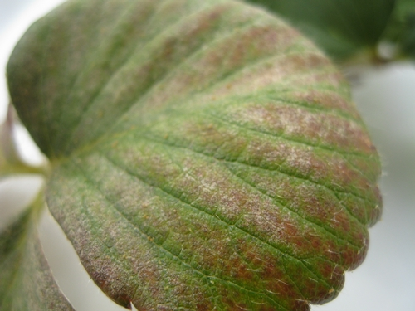
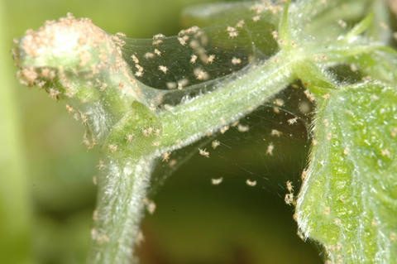
Spider Mite Leaf Damage
The earliest and most obvious sign of these pest mites is yellowed or bronze stippling on the outer surface of leaves.
Infection normally appears on lower leaves first
Leaves may shrivel and fall off prematurely.
Webbing covers all plant parts in the later stages of severely infested plants.
Drought stress and high temperatures usually worsens the problem
Left untreated they can kill entire plants

Slide 13
Spider Mite Control
Spider mites need aggressive control, so infestation doesn’t build up in your garden.
Check plants (underside of leaves) regularly for spider mites
Keep plants healthy. Spider mites thrive on plants under stress
Physically remove infected leaves.
Use a high-pressure water spray to dislodge spider mites, repeat every few days
Natural enemies can reduce two spotted spider mites
Horticultural oil
  JMS stylet oil 4T/gallon of water (you need to apply to underside of leaves)
  Repeat every few days
Miticides
  Some will kill all stages of life cycle (again you need to apply to underside of leaves)
  Mitcides are all very toxic to humans and are very expensive
  Avid, Akari, Floramite
  Because of the rapid life cycle of spider mites they build up immunity to miticides very quickly so you need to use them sparingly and use different types

Slide 14
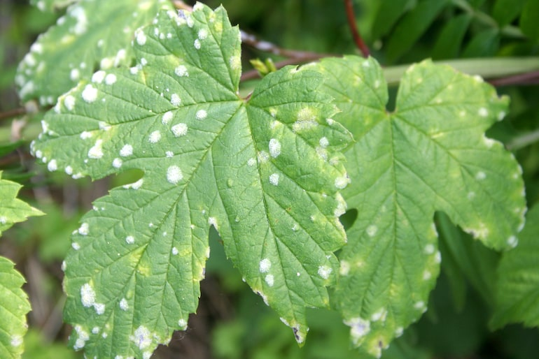
Powdery Mildew
Powdery mildews prefer high relative humidity (greater than 95%),moderate temperatures (68°- 86° F), and low light intensities.
The disease is more prevalent in the spring and fall when large differences between day and night temperatures occur
Control
  Avoid Watering from Above
  Maintain Good Lighting or Sunlight
  Introduce Air Circulation
  JMS stylet oil (will kill powdery mildew on contact)

